Slide 1
Hooking Vtables
CSC 840 – Spring 2016
Josh Stroschein

Slide 2
Why I care
Dissertation research is focused on reverse engineering and security vulnerability discovery
How to better secure software
What can attackers do?
How can they modify execution of a program
More advanced understanding of dynamic and static analysis
Plus Windows API

Slide 3
Three Main Ideas
It is difficult to defend applications when an attacker has the program
Even when it’s just binary data
Windows API allows for a tremendous amount of flexibility and can be leveraged directly
Indirect calls can lead to security vulnerabilities/exploitation

Slide 4
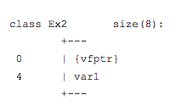
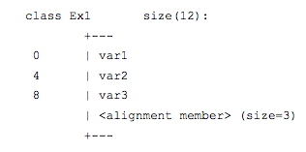
What is a vTable?
An array of function addresses, used when a base class overrides a parent class’s virtual functions
A pointer to an array of pointers
When a class has virtual functions, this vtable is created
Becomes the first ’member’ of the class
vTable Pointer

Slide 5
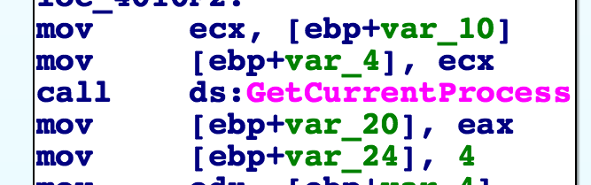
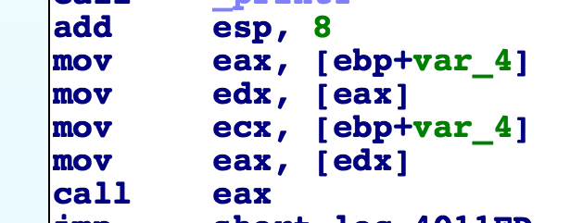
Indirect Calls
’Normal’ call – address is determined when program is compiled
This can be checked
Indirect – address is determined at runtime
This can be abused

Slide 6
Future Direction
Understand further mitigations that would prevent vTable hooking such as Control Flow Guard in Windows 10 and 8.1
Accomplishing vTable hooking through DLL injection on a running process
Accomplish vTable hooking by DLL injection at load time
Explore new mitigation techniques

Slide 7
Resources
Control Flow Guard: http://blog.trendmicro.com/trendlabs-security-intelligence/exploring-control-flow-guard-in-windows-10/
MSDN: https://msdn.microsoft.com/en-us/dn308572.aspx
vTable Hooking: https://webcache.googleusercontent.com/search?q=cache:6F04VbD3q3YJ:https://s0beit.me/reverse-engineering/how-vtable-hooking-works-detecting-it/+&cd=1&hl=en&ct=clnk&gl=us

